Slide 1


ECEN 404
Team #44
Biweekly Update 5
Cubesat EM Material Discharge Eval:
Ian Poynter
Joshua Feldman
Michael Kim
Alejandro Torres
Sponsor: Orbital Arc & SATOP
TA: Souryendu Das

Slide 2
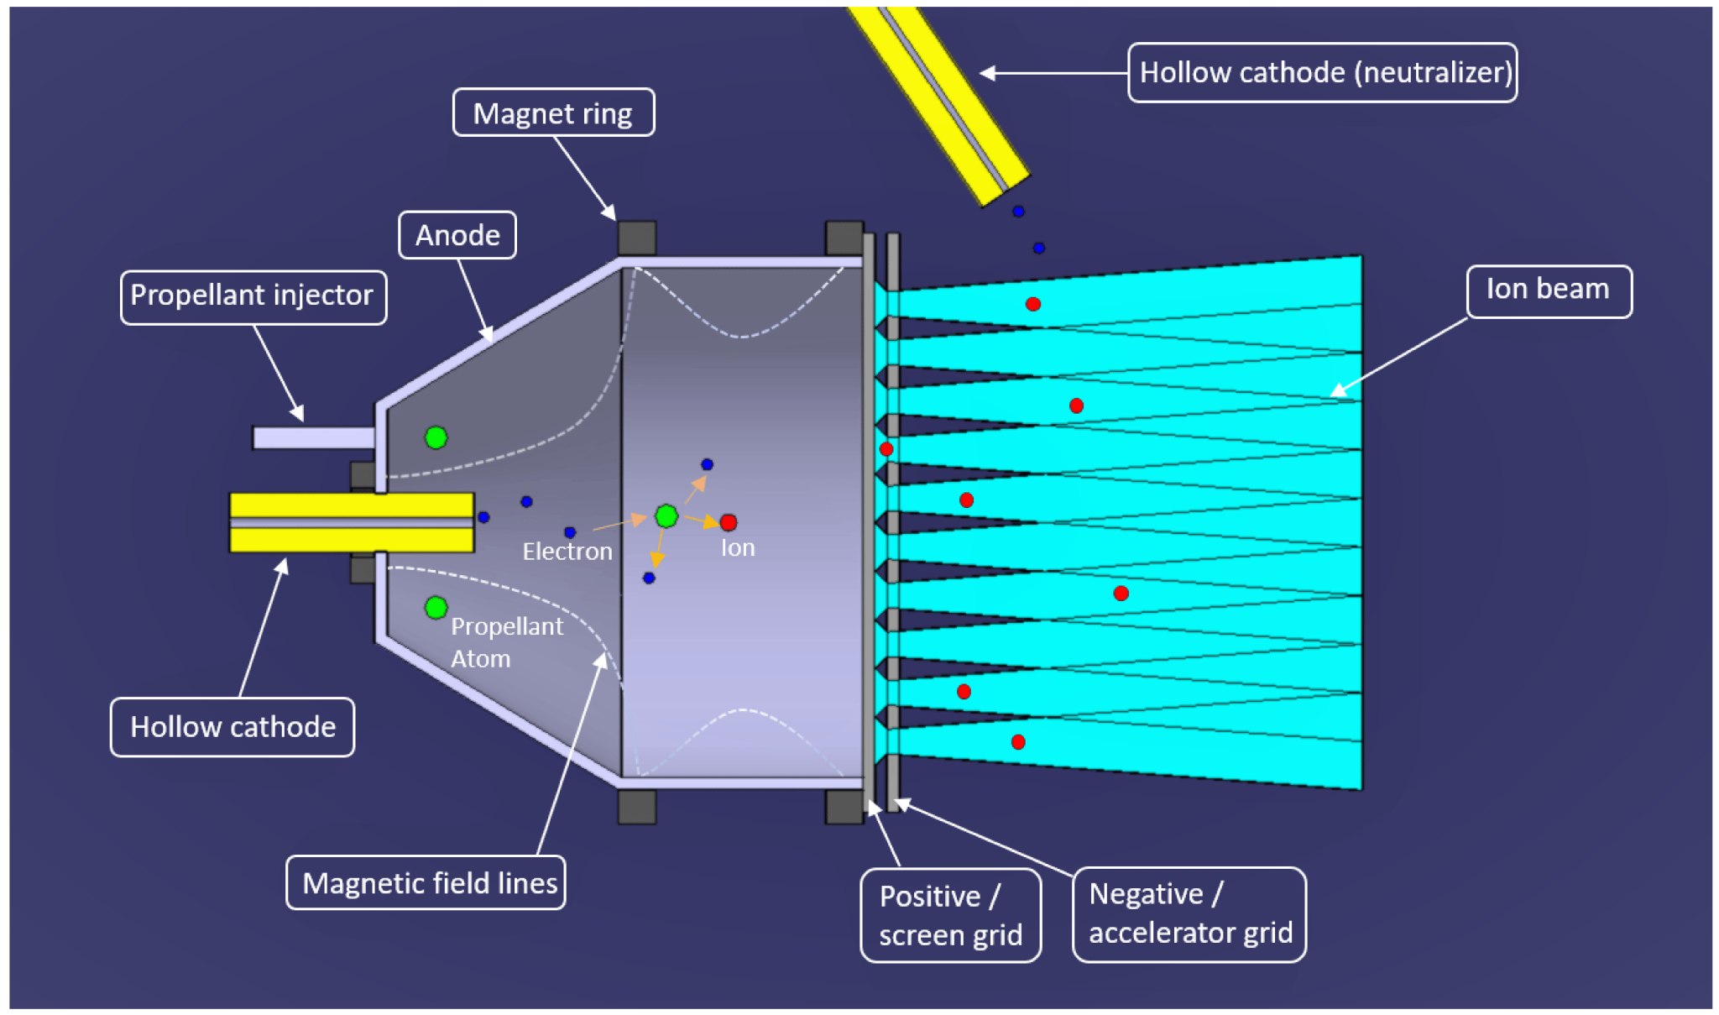
Problem Statement
Current Ion Thrusters have limited use cases due to many factors, including fuel cost and harsh ionization methods

Slide 3
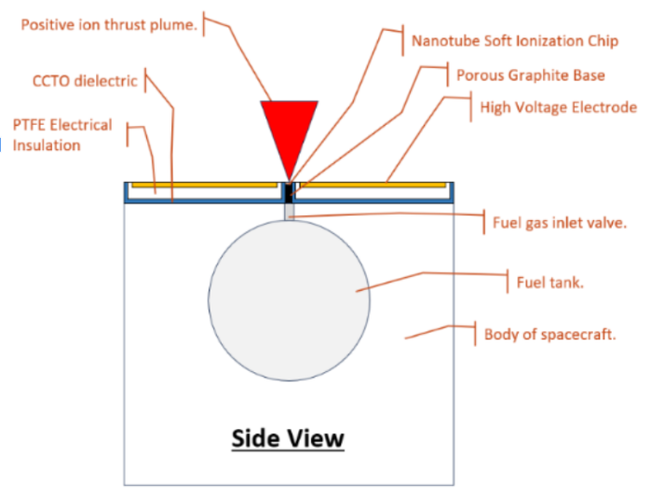
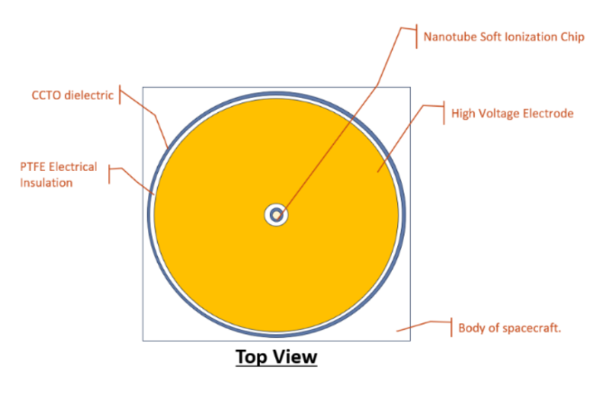
Project Summary
RIOT Drive: New type of Ion Thruster that will reduce these limitations and operate with higher efficiency
Solution
Develop a prototype for the RIOT Drive
Internal Hardware
Power Supply
Microcontroller
Accelerator Plate
Geometry Selection

Slide 4
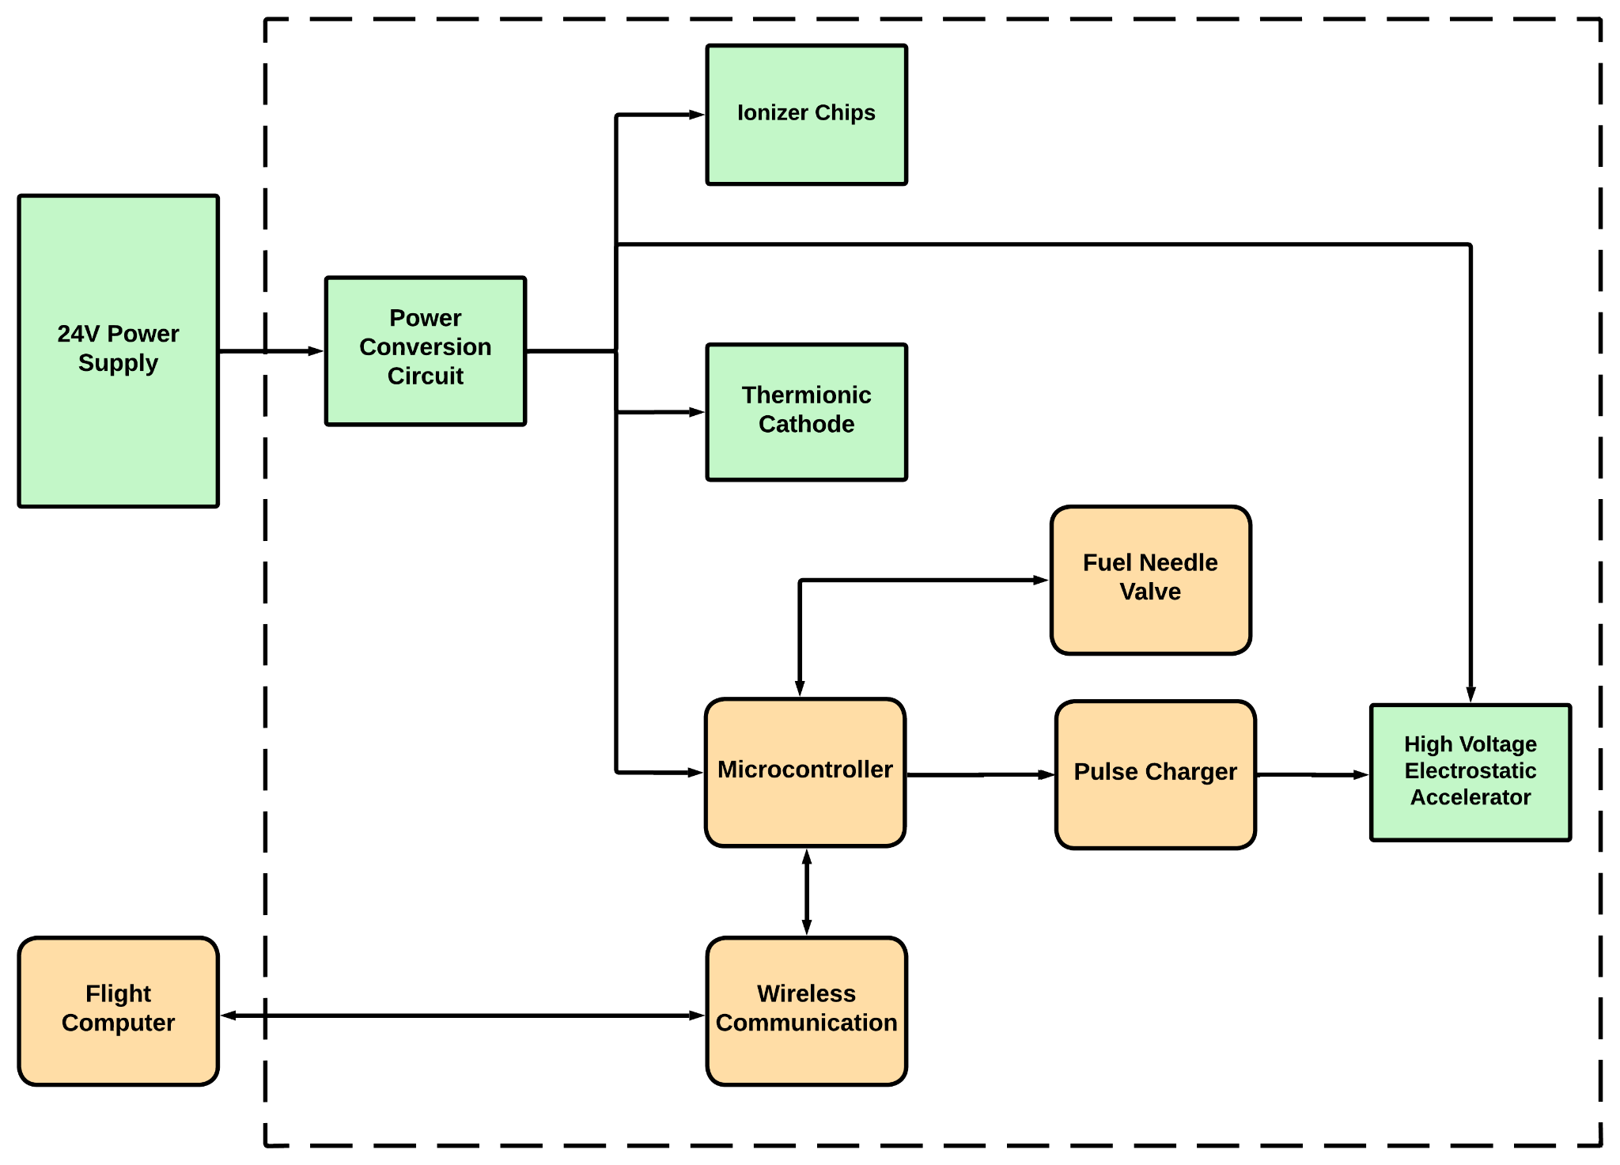
Integrated System Diagram
(RIOT Drive)
Notes:
Kyle

Slide 5
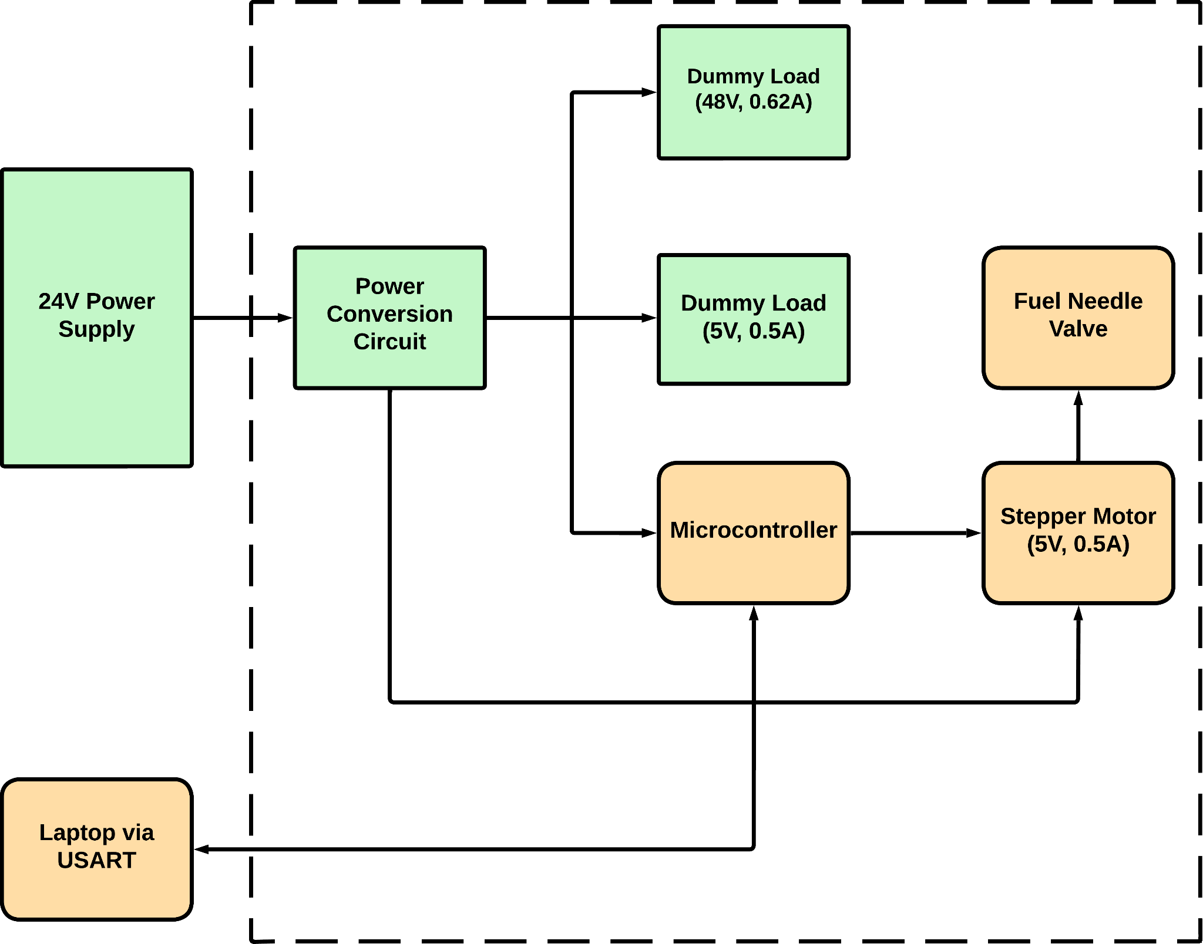
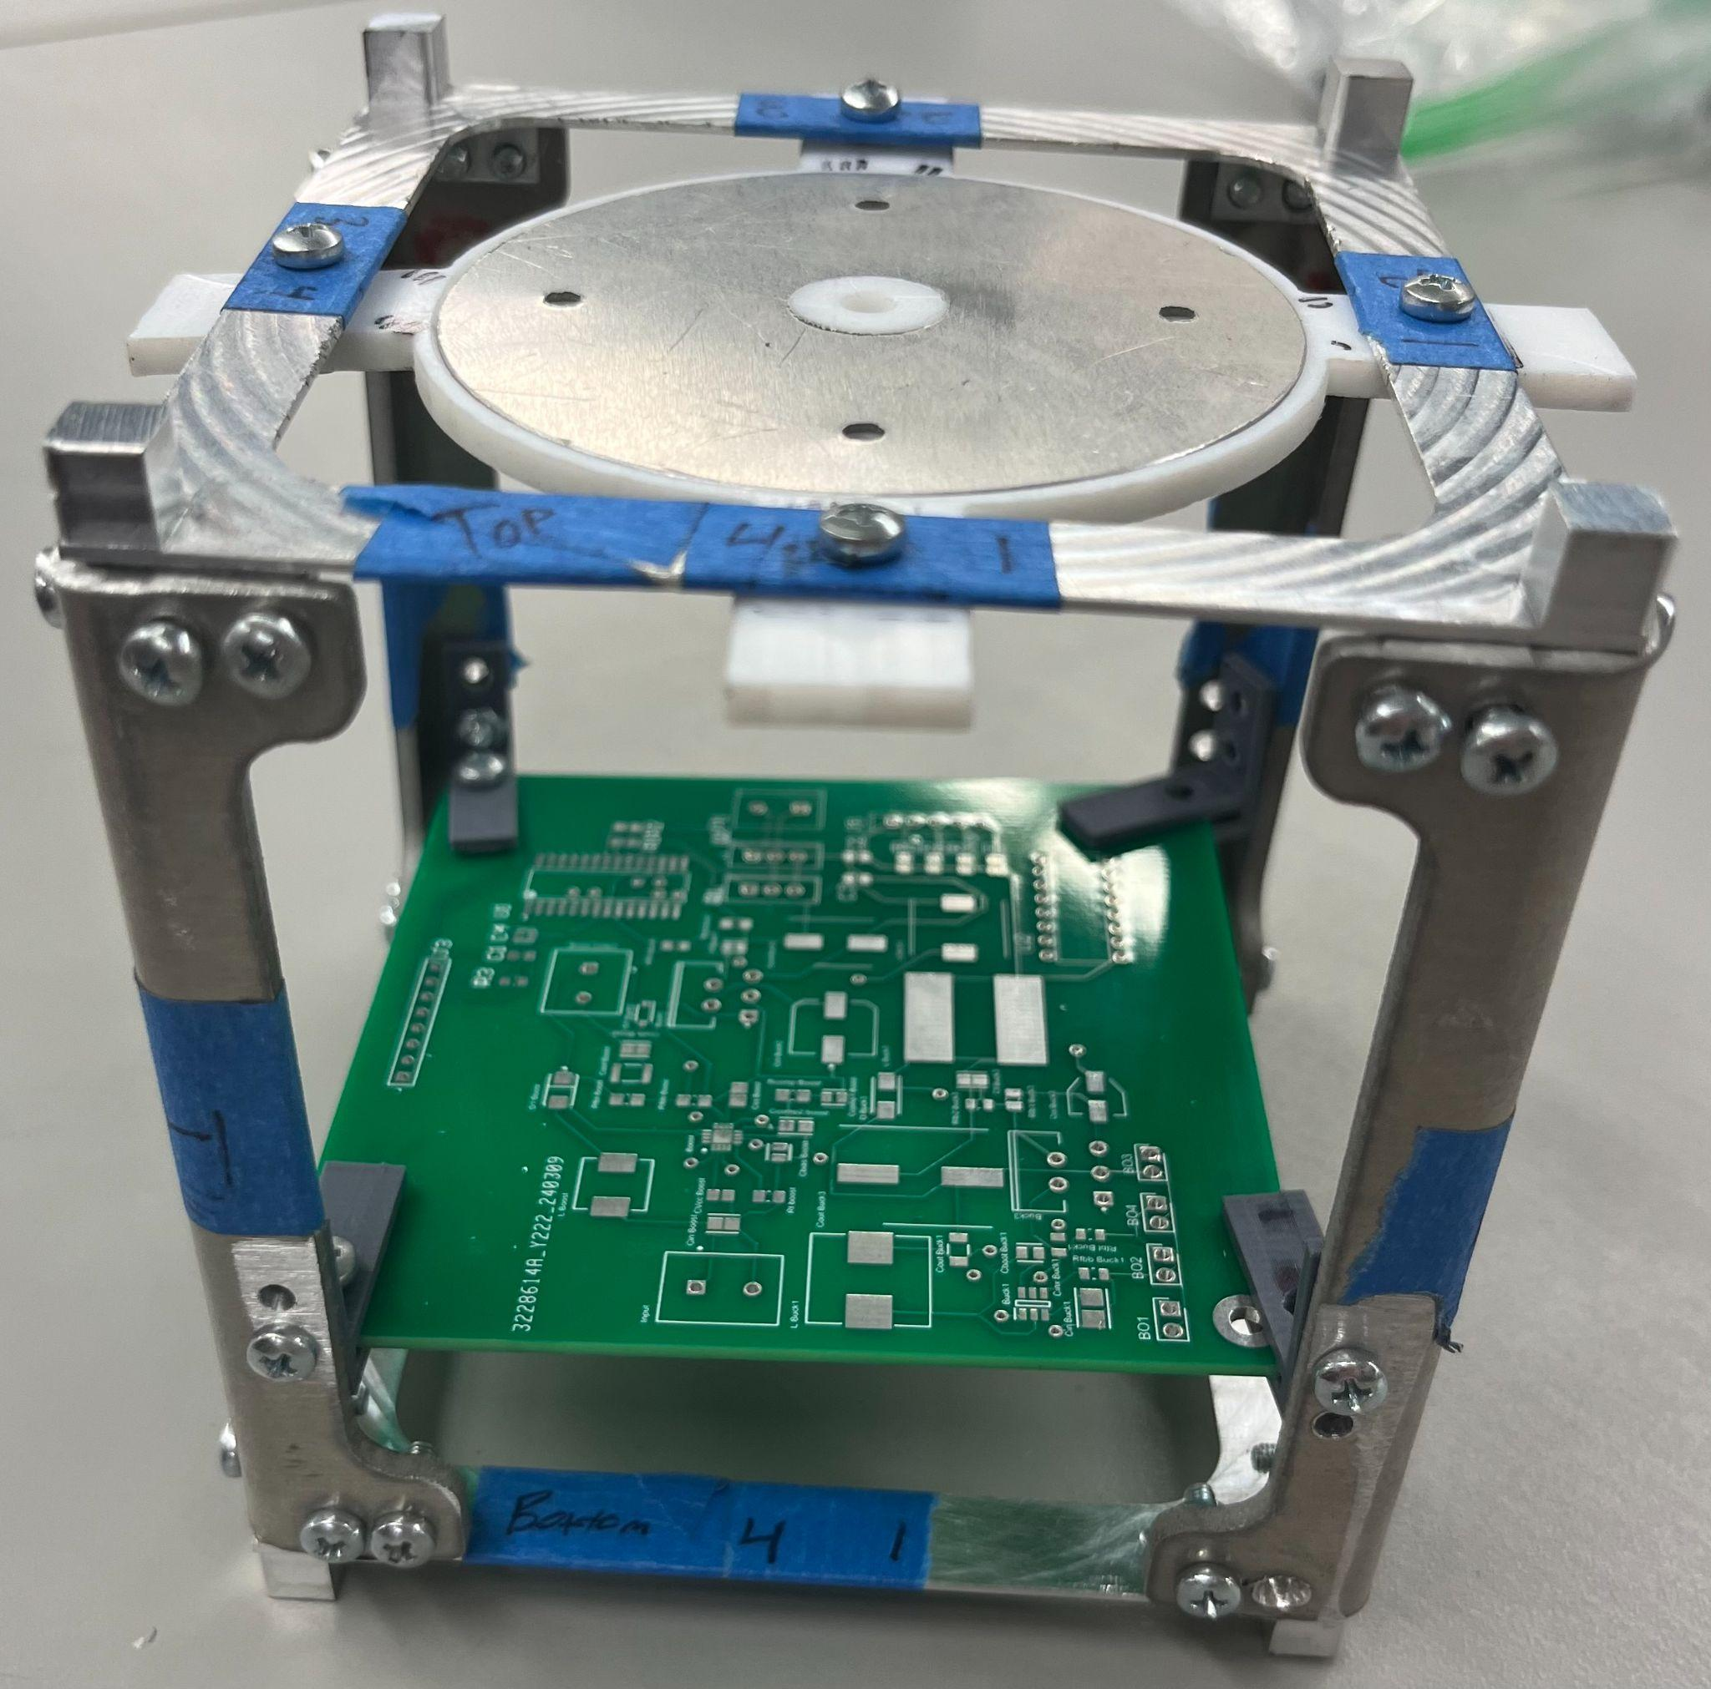
Integrated System Diagram
(Prototype)
Notes:
Kyle

Slide 6
Project Timeline
Mechanical Subsystems Design and Testing (completed 12/3) | Hardware Subsystems Redesign and Testing (to complete by 2/22) | Integration of Microcontroller and Power Subsystems (to complete by 3/18) | Component Selection for Accelerator Plate (to complete by 3/28) | Validation of Integrated Hardware (to complete by 3/28) | Final Integration (to complete by 4/12) | Final Demo (to complete by 4/19)

Slide 7
Alejandro Torres
Accomplishments since last update 21 hrs of effort | Ongoing progress/problems and plans until the next presentation
New integrated PCB fully soldered. Successful connection with the Microcontroller. Final PCB iteration ordered. | Solder and test final PCB.

Slide 8
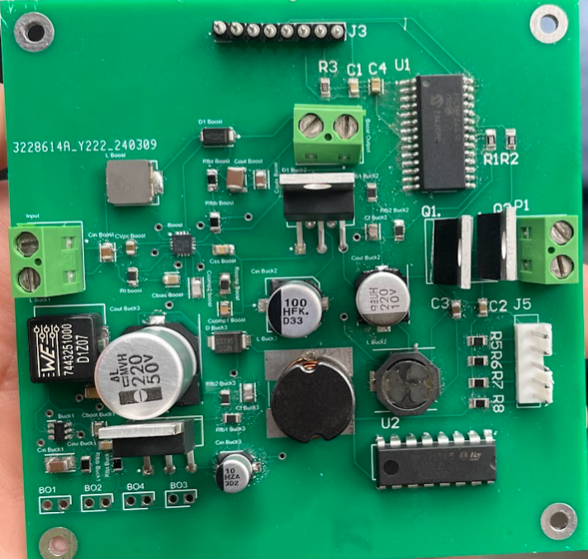
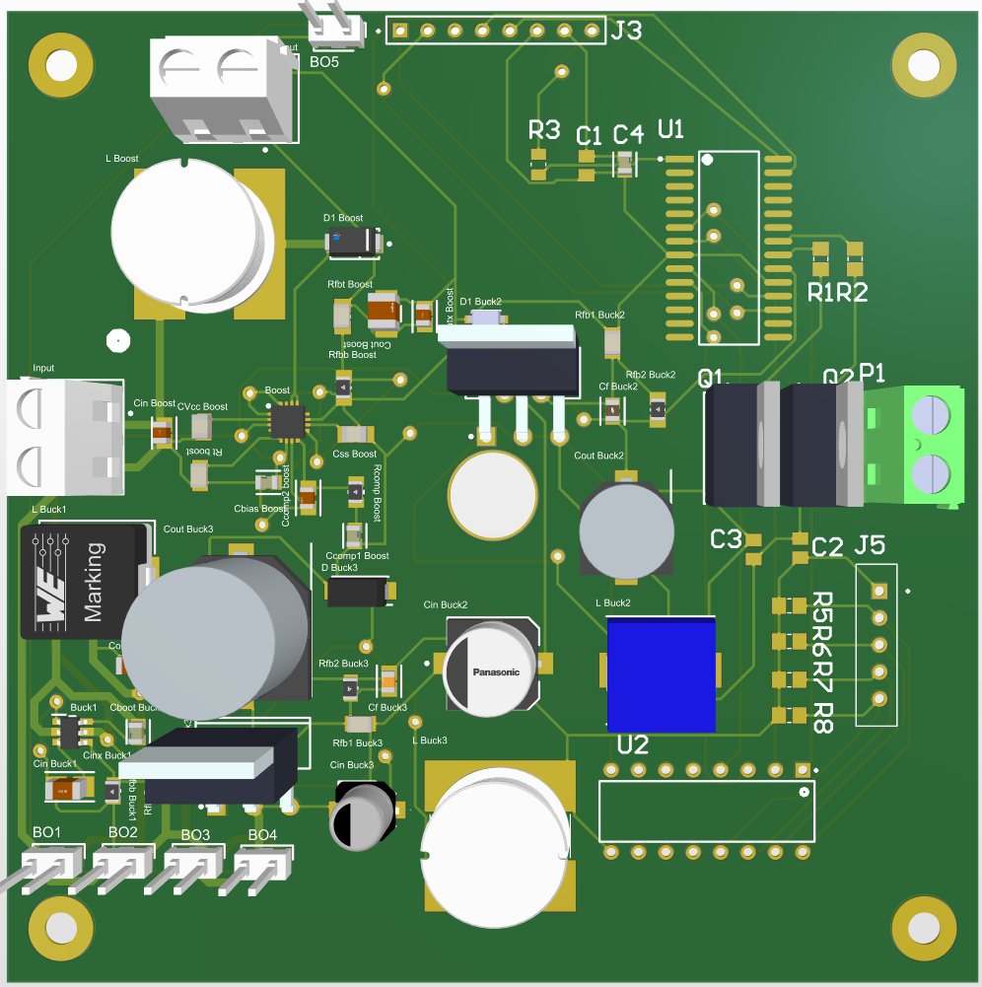
Alejandro Torres
New PCB included modifications to work with desired current levels for one buck converter.
Includes a hole in the middle of the board for the fuel tube to go in line with the ionizer.
Boost converter also modified to fix current output issues.

Slide 9
Joshua Feldman
Accomplishments since last update 18 hrs of effort | Ongoing progress/problems and plans until the next presentation
Validated final PCB design with sponsor and Alejandro. Validated power consumption of stepper motor and control through USART. Validated power consumption of Microcontroller from Buck Converter. | Test stepper motor connection to mass flow valve. Test and validate flow rates of mass flow valve. Work with USART cable outside of debugging on MPLAB.

Slide 10
Ian Poynter
Accomplishments since last update 20 hrs of effort | Ongoing progress/problems and plans until the next presentation
Integrated mounting and chassis to hold PCB Machined chassis to provide mounting for accelerator plate | Design and fabricate stepper motor and gas valve connector Validation of integrated PCB and dummy loads through E-load

Slide 11
Michael Kim
Accomplishments since last update 16 hrs of effort | Ongoing progress/problems and plans until the next presentation
Fabricated metal and teflon pieces of accelerator plate. Validated specs of the fabricated plate. Machined mounting of the plate for chassis. | Test integration of plate through mounting and PCB.

Slide 12
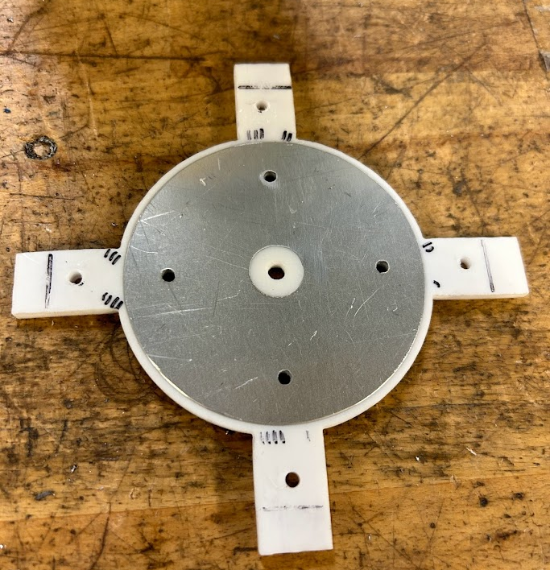
Ionizer

Slide 13
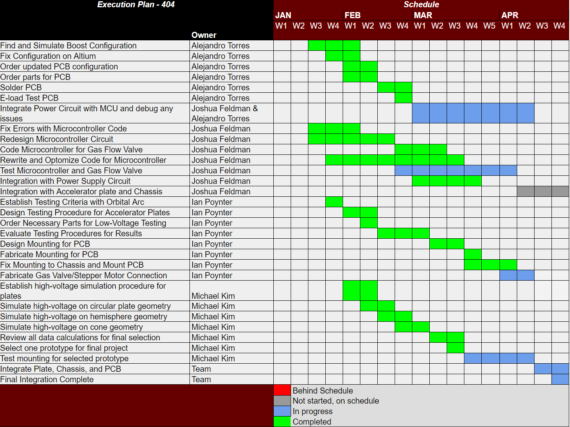
Execution Plan
Notes:
Michelle

Slide 14
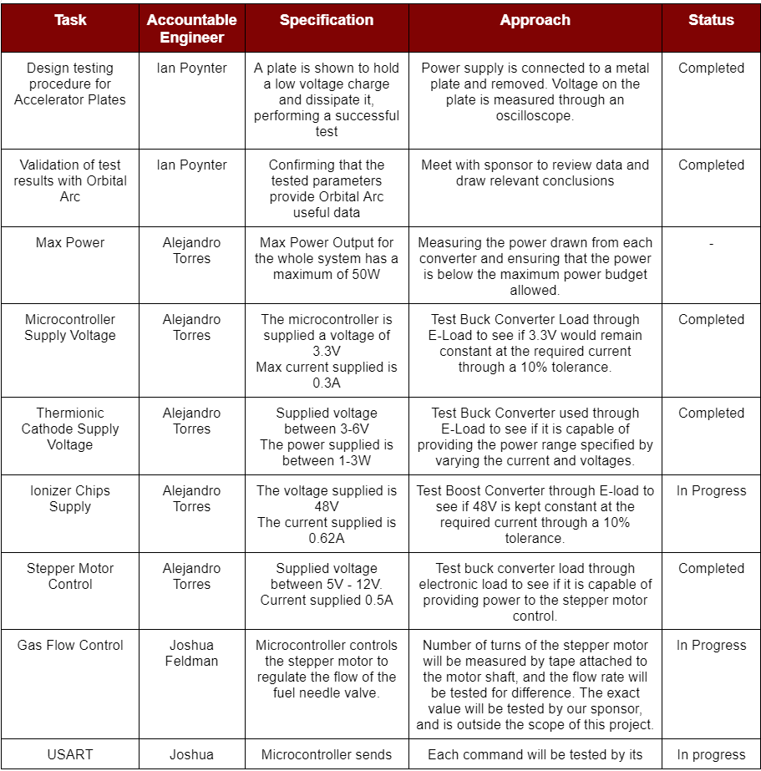
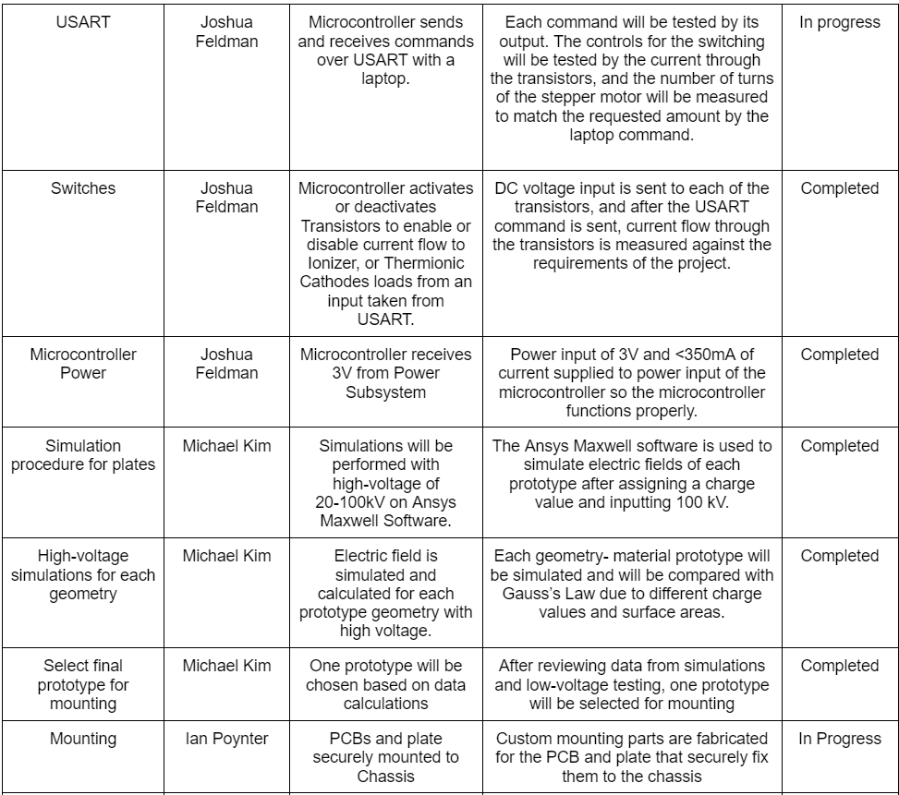
Validation Plan

Slide 15

Thank you!

